Slide 1
Making a shadow
Matilda is thinking about how a shadow is made.
Sun

Slide 2
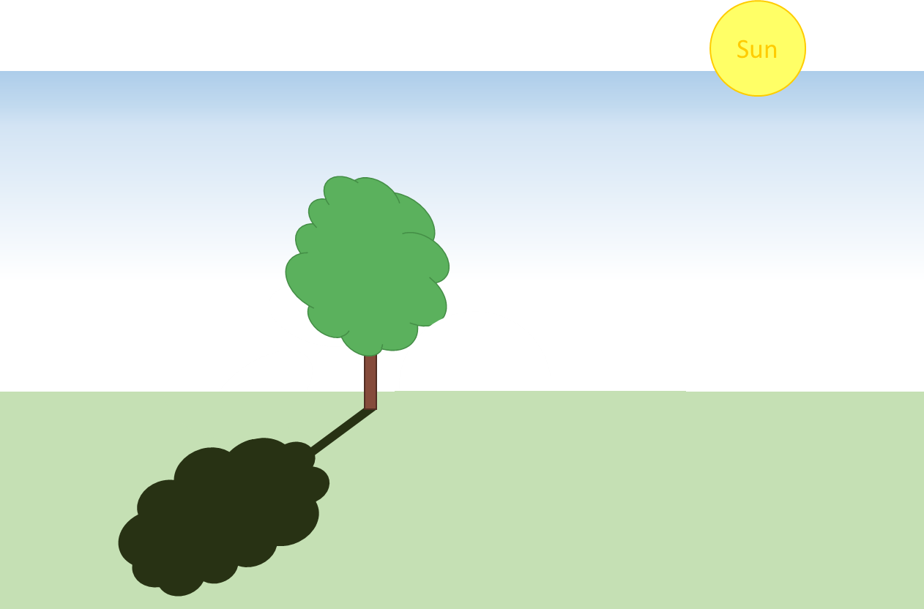
Making a shadow
Which is the best description of how the shadow is made?
A
The light can’t pass through the tree so the grass is not lit up.
B
The light sets off from the sun but can’t cross the tree so it’s black.
C
The tree stops the sun from shining any further, so the tree makes the shade.
D
The Sun shines on the tree, and the shadow is a reflection of the tree.

